Slide 1


Understanding Addiction
Patrick Choy MSW RSW
Javeria Arshad M.Ed

Slide 2
ASYR: Who are we?
ASYR is a non-profit agency located in York Region
We offer services that range from community treatment, withdrawal management, adult services, and youth/family services
Our approach is harm-reduction with our focus on client-centered service
Notes:
Javeria

Slide 3
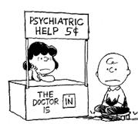




Who am I? What am I doing here?
Notes:
Patrick
https://www.youtube.com/watch?v=CM5mFH3_Qhs
By using this video as an example, who do you think the counsellor is? (The one who pushes the stone?). No actually it is the ones that are sweeping. (Provide support, make it easier for the individual to make the shot that he/she wants)

Slide 4
Youth and Family Program
Individual counselling for youth ages 12-24
Family and Couple counselling
Parent Support counselling
Parent Group
Notes:
Javeria
Pause for translation.

Slide 5

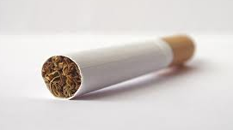
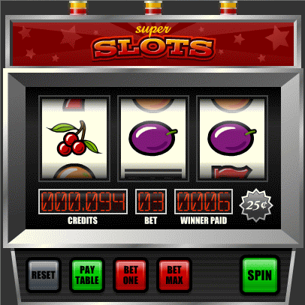
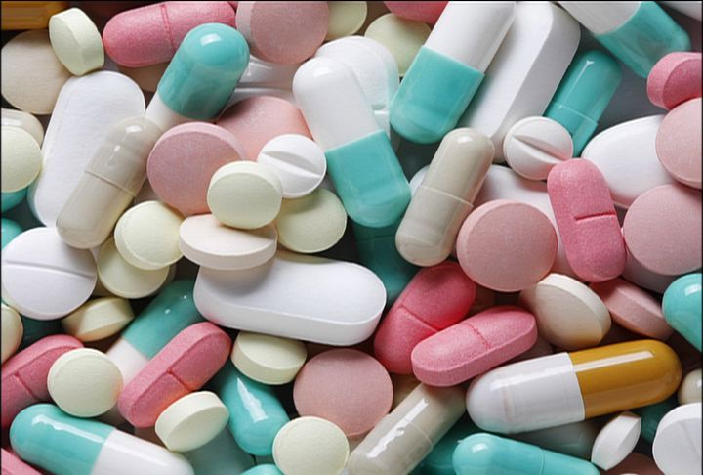
Simple definition of addiction
Any behaviour which continues despite long-term negative consequences.
Often involves cravings, compulsion, loss of control.
Notes:
Patrick

Slide 6


Addiction occurs on a continuum
Notes:
Javeria
Pause for translation

Slide 7
Drug Use Continuum
No use Experimentation Recreational Regular Dependent
Lack of Access
Belief/Value
Bad Experience
-Novel Experience
-Curious
-Low Tolerance
-Pressure to fit in
-Externally Motivated
-Social Use
-Adds to life
-Can control
-Reactions Predictable
-Increased tolerance
-Attempts to Control / Limit
-Some major life areas affected
-Drug use continues
-Pattern
-Coping Mechanism
-”Takes Over”
-Constrains many significant life areas
-Strong emotional pain (loss)
-Pre-occupied
-High tolerance
-Internally Motivated
-Isolated
Notes:
Javeria
Pause for translation
FACILITATORS NOTES:
Remember, this is not a timeline. If your youth is at the experimentation stage that does not guarantee that s/he will move to the regular or dependent stage. One cannot predict someone’s substance use path. Some young people may shift from one drug to the next. Others may stick with their original drug of choice. And others still may become bored with using, and outgrow their use altogether.

Slide 8
Reflection Question
What are some issues/concerns transitioning youth experience?
Notes:
Patrick
Eg:
being bullied
parents going through a divorce
going through a divorce
dealing with the death of a loved one
involvement in a car accident
coping with a physical health problem
growing up in a war-torn country, leaving the country you came from or adjusting to a new country (which often means dealing with immigration and resettlement experiences)
dealing with racism or other forms of prejudice (because of sexual orientation, age, religion, culture, class, etc.)
having a low income or being homeless
not having equal access to education, work and health care
having a history of mental health problems in the family
being a victim of violence, abuse or other trauma

Slide 9
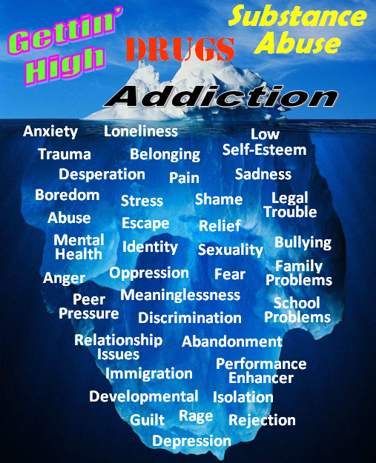
Notes:
Patrick

Slide 10
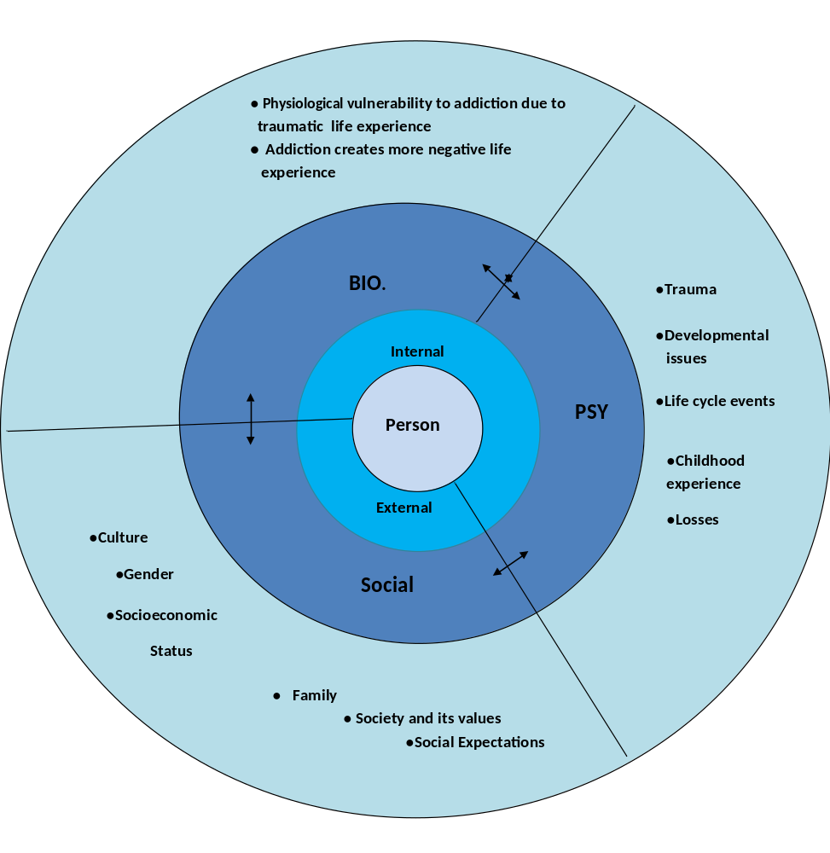
Biopsychosocial, Holistic Model
Notes:
Javeria
Pause for translation

Slide 11
The Ground Work…
Trust & Respect
  Authentic Relationship is everything
    Does the youth see me as safe, caring, and capable of helping?
    Does the youth feel that I see them as a whole person – or have I reduced them to something less than… (e.g. based on their drug of choice, a diagnosis, a repeated behaviour, etc.) When working with Youth, this is almost always the first issue we face.
Notes:
Patrick

Slide 12
The Ground Work…
Trust & Respect
  Youth as Teacher
    Questions (without an agenda) are usually well received and give opportunity for the Youth to demonstrate their capabilities and skills – especially around ‘drug culture’
    “Sesh”, “Molly”, “Baccy” - the ‘lingo’ constantly changes – if you don’t know, ask!
Notes:
Patrick
Pause for translation

Slide 13
The Ground Work…
Trust & Respect
  Acknowledging their Power is…Empowering!
    Strengths-based approach
    Resiliency
    Internal motivation for change
Notes:
Javeria

Slide 14
The Ground Work…
Understand the context
  Vast majority of youth we see are externally pressured to seek treatment – who are the invested parties?
  Addiction as systemic issue – when youth “acts”, who “responds”, and how?
  “Best practice” is to involve the family, as defined by the youth, being mindful of the safety of doing so – i.e. respect youth’s right to confidentiality

Slide 15
The Ground Work…
Understand the context
  The “problem behaviour” of the youth does not occur in isolation. When one part of a system changes, the other parts are forced to adapt to try and regain balance in the system.
  Who ‘benefits’ from the continuation of the behaviour? From the ceasing of the behaviour?
Notes:
Javeria
Pause for translation

Slide 16
Reflection Questions
Is change (whether behavioural or attitude and mindset) easy?
Did our will to change swayed at times?
If we had been successful in making changes in the past, did those changes happened in a single try?
Notes:
Patrick
Pause for translation
Sometimes change is like flipping a light switch, on/off. But often, it is a gradual process that involves ongoing support, it drains our energy, our motivation sway at times, and the fact is that sometimes we failed at changing altogether.
So…. The question is, is there a formula that ensures a long lasting change? The short answer is no. But there is a tool that we often use in our agency that could let us see change in a different perspective.

Slide 17
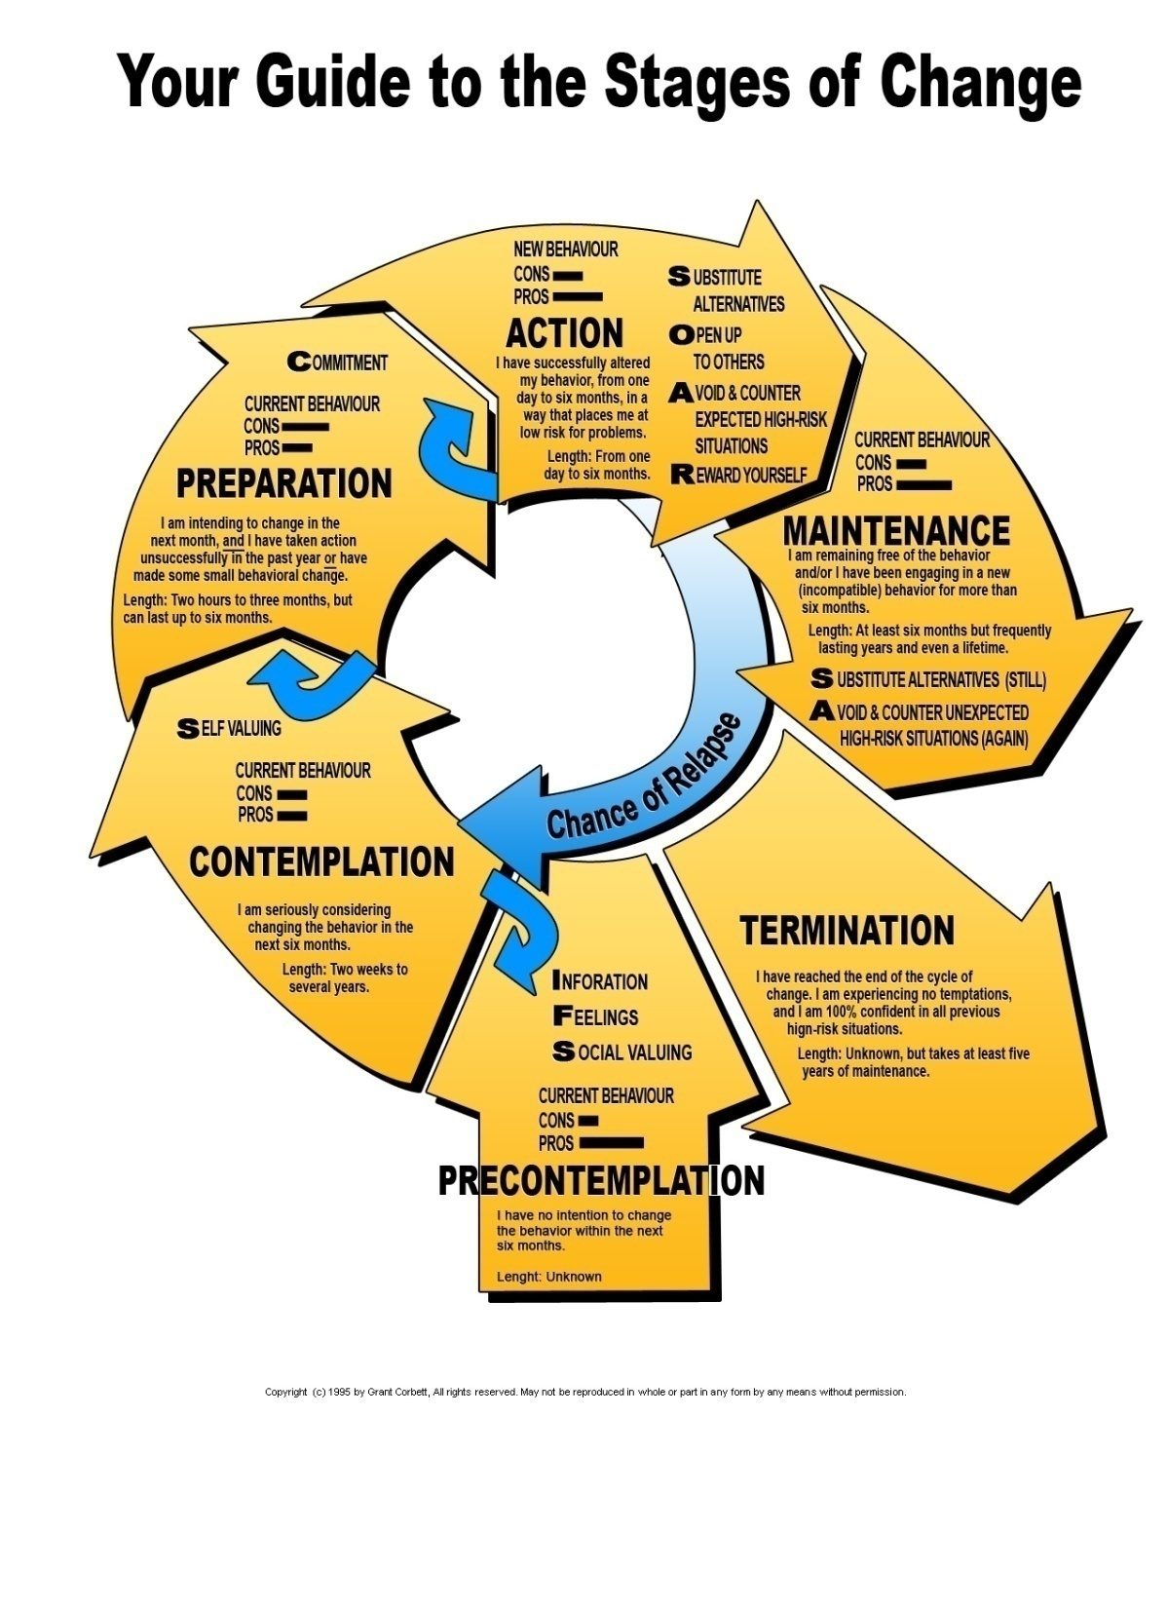
Notes:
Patrick
Pause for translation
Talk about each stage.
***The stages of change is not always a linear process, sometimes a person can shift back to a previous stage, or quickly move from one stage to the next. The stages of change helps us understand where the youth is currently at. Rather than using immediate cessation of drug use as the measuring stick for being successful of not, stages of change sets a more relatable and realistic goal/expectation according to the youth’s current stage***
(After having those realistic goals/expectations, Again communication and attachment is the most important because into action by working together with the youth.)

Slide 18
What is Stigma?
“Stigma” is a socially constructed label that refers to negative attitudes people hold toward others whom they deem “different” or “other” to themselves. It is manifested in bias, distrust, stereotyping, fear, embarrassment, anger and/or avoidance (Penn & Martin 1998).
How do we contribute to stigmatization?
Sometimes we are aware and other times not so much
Notes:
Javeria
Pause for translation

Slide 19
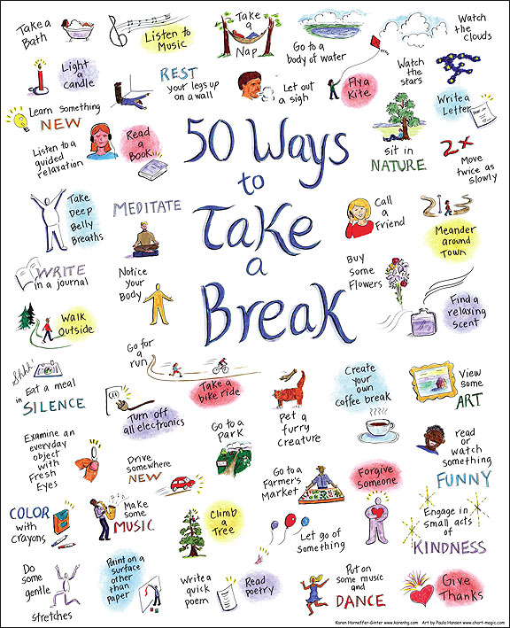
Notes:
Javeria
Pause for translation
Oxygen mask

Slide 20
Other Resources for Parents
Support groups: Al-Anon, Nar-Anon, APSGO, CAMH
Parent Support phone line 1-855-DRUGFREE
Notes:
Javeria
APSGO, association of parent support groups of ontario
http://www.drugfree.org/community/parent-support-network/

Slide 21
Addiction Services for York Region
Contact us if you have any questions or concerns
905-841-7007
www.asyr.ca
Notes:
Patrick
Pause for translation
Remind parents about our services

